Slide 1
APP DESIGN
Liane Stevenson @webdevelopwolf www.webdevelopwolf.com

Slide 2
INTRODUCTION
What to learn

Slide 3
What are we doing today?
Why design our apps?
Stages of app design
Benefits of app design

Slide 4
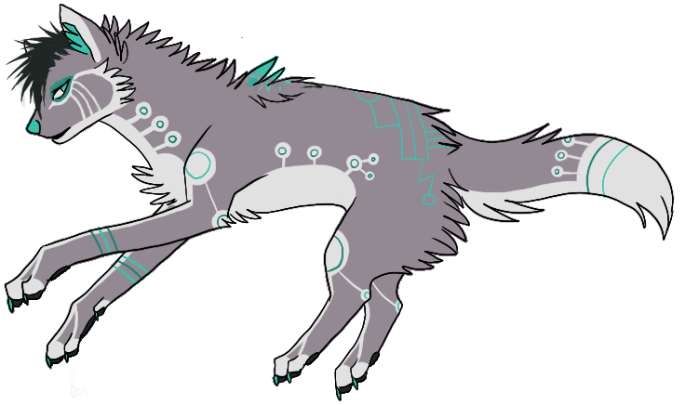
Need help?
Github:
http://www.github.com/webdevelopwolf/training
Twitter:
http://www.twitter.com/webdevelopwolf
Facebook:
http://www.facebook.com/webdevwolf

Slide 5
APPLICATION DESIGN
Those who fail to plan…

Slide 6
WHY CAN’T WE JUST GET STRAIGHT IN THERE AND START CODING???
A mobile app is released on iOS or Android at least 8 times a day.
Most global corporations have their own apps and development teams to match their size
Apple monitor application quality and control the content on their own store
There’s a high amount of pressure to ‘get it right first time’

Slide 7
8 STEPS OF MOBILE APPLICATION DEVELOPMENT
1 Define the project and the need for it to exist
2 Know your enemy user
3 Involve the client / customer / development team / employer etc.
4 Outline the flow of the application in a Storyboard
5 Collect all your data
6 Build a user interface
7 Link the app to your data
8 Test and release the app

Slide 8
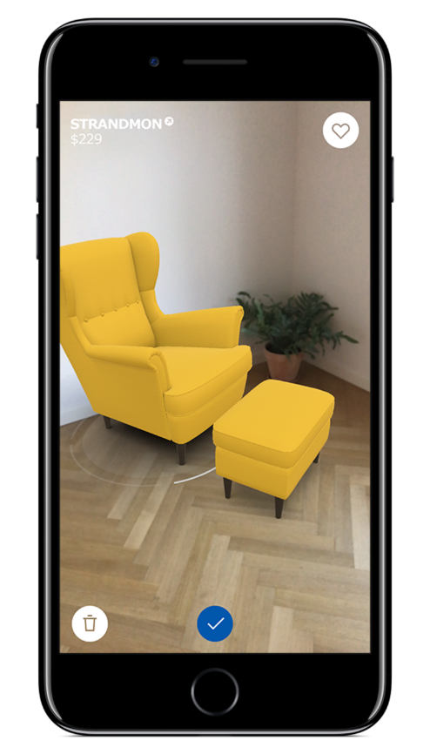
Step 1 Define the Project
Every application should exist to fix a real-world problem
Booking App for a Hair Salon
Product Catalogue for a Furniture Store
Food Delivery and Tracking App
Therefore every app has a mission
Clients can book on-the-move
Customers can browse at leisure
Customers can track their food

Slide 9
Step 1 Define the Project
This gives us a mission statement which should tell us what we want our finished product to do:
“To design and build an application that allows our customers to track their deliveries so that they may avoid waiting home for parcels”

Slide 10
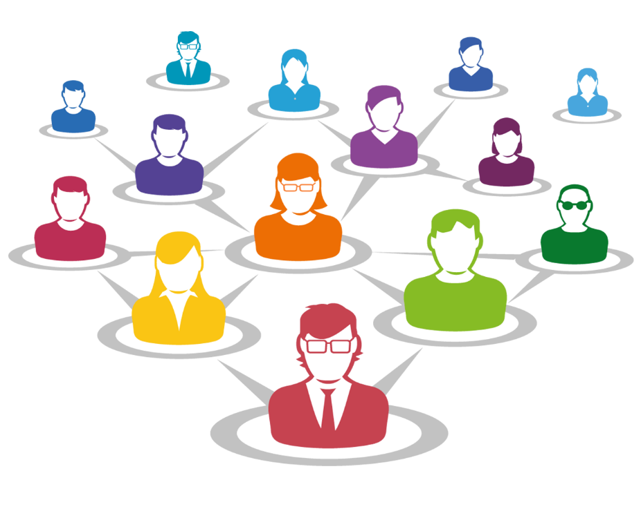
Step 2 Know Your User
The more you know about your user, the more you know about your app
Users can usually be broken down into groups of reasons to use the app for example for Facebook:
Keep in touch with friends & family
Build an online photo album
Promote my business
Send viral messages to large groups of people
All of these people will use Facebook differently

Slide 11
Step 2 Know Your User
The users for our tracking app fall into two groups:
Drivers, the ones who update the app with correct delivery times and status
Customers, the ones who track where goods are and when they will arrive
There are also some things both groups might want such as:
An easy-to-use design
A secure login
To be accessible
All these combined give us the app’s requirements

Slide 12

Step 3 Involve Your Stakeholders
First of all…who or what is a stakeholder?
Users
Employers
Clients
Customers
And any one else who is effected by the success of your app
Talk to people about your idea
Take on board criticism they might have
But don’t let them run the project

Slide 13

Step 4 Storyboarding
The story of how we get from A to B
Answers questions about how users will user your app
Does it flow?
Is it easy to get the job done?
Are there any blockers or hurdles?

Slide 14
Step 4 Storyboarding
There’s many ways to make a storyboard:
Pen & Paper
Post-it notes or index cards
Online tools such as InVision or Canva
Desktop tools like Photoshop or Gimp
See my Github for an example of a basic storyboard

Slide 15
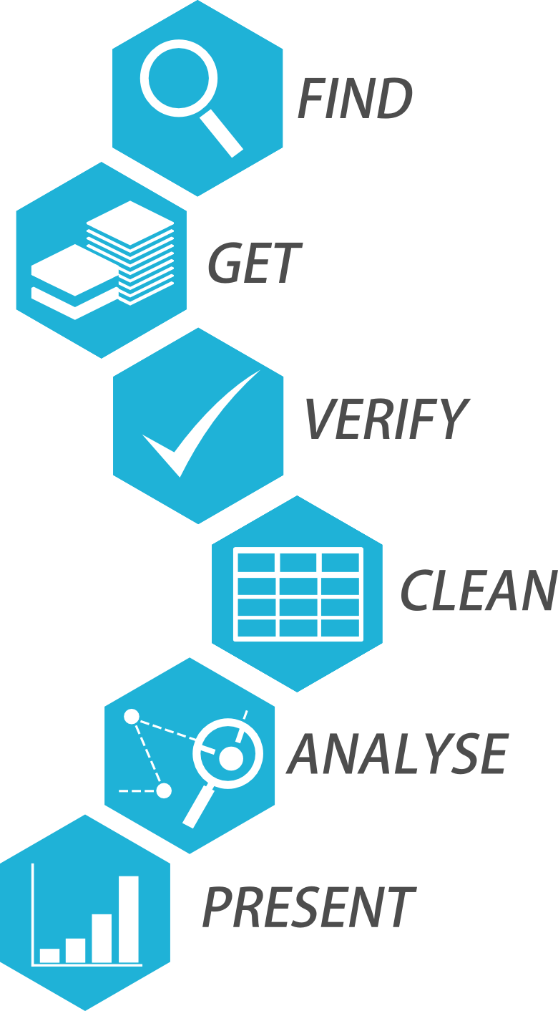
Step 5 Collate All Your Data
Our app is going to contain static and dynamic data
Static data doesn’t change over time and is very often hard-coded into the app
Dynamic data can and will change over time therefore we need a dynamic data source such as an API or database to manage this or maybe even both
At this stage of the project we only need to worry about collating static data as the dynamic data will be handled by our C# application further down the line in the project

Slide 16
Step 5 Collate All Your Data
This is less important for a personal project but can be crucial when working on a commercial project
Best way to do this is to construct a spreadsheet or other tabulated method (such as a table in Word, or records in Access)
For an example of this see my Github

Slide 17
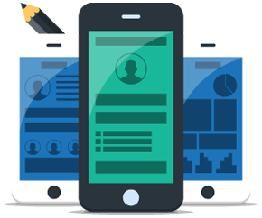
Step 6 Build A User Interface
We’ll go into this in more detail as we go, however here’s some things we need to be thinking about:
Is it accessible?
Is it pleasing to your target audience?
Does it suit a touch screen display?
Ionic will handle most of this for us out of the box
If you plan to branch out and use your own designs these are the things that always need consideration

Slide 18
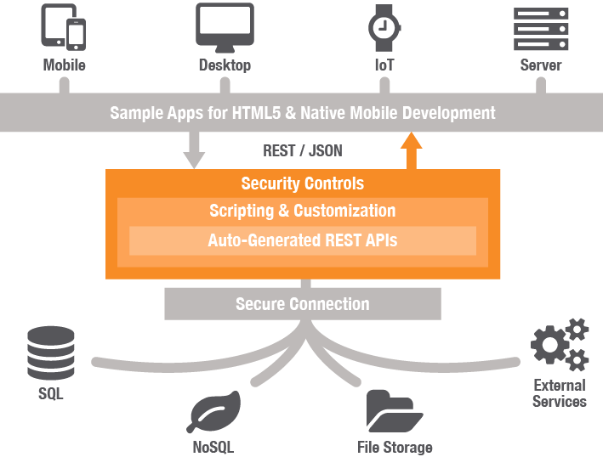
Step 7 Hooking Into Your Data
These are our dynamic data sources, but again here’s some things we need to be aware of:
How do we want to get our data?
Where do we want to store our data?
How easy would it be to intercept?
Will our app still load if this data were unavailable?
Our application will be a C# Web API 2.0 app serving JSON data

Slide 19
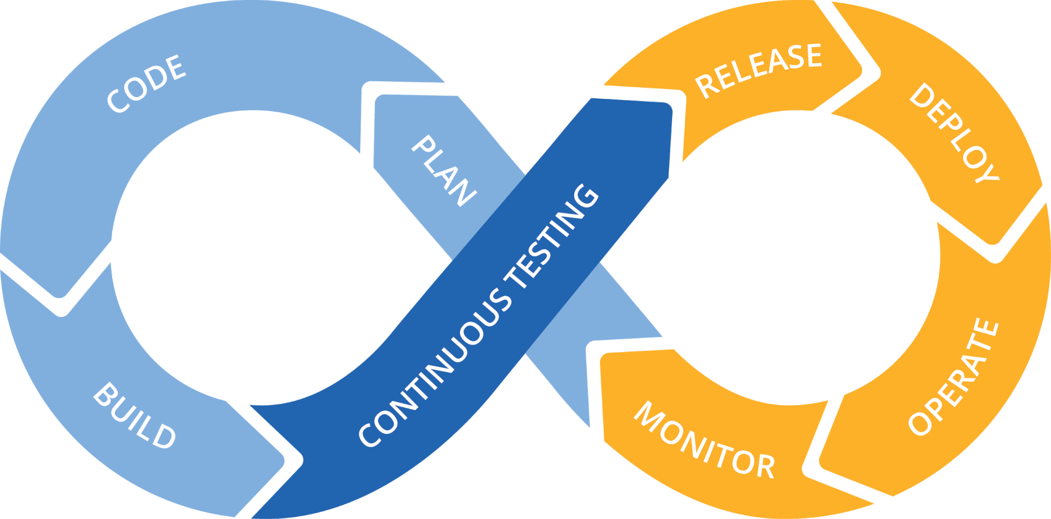
Step 8 Test & Release App Cycle
Why is testing important? Users are a pain in the backside!
They break what’s there
They ask for what’s not there
They use what’s there for something completely different
They complain about things you never knew existed until they complained

Slide 20
Step 8 Test & Release App Cycle
When it comes to release time you have a few options:
Cloud release (such as Azure, Amazon Web Services etc.)
Web hosting this can be free or paid and offers a whole variety of options to fit most projects and budgets
Host from home anyone can do this with the right settings on their router, a spare computer and will work better with a static IP address from your internet provider

Slide 21
WHAT DID WE LEARN THIS TIME?
Why design our apps?
Stages of app design
Benefits of app design

Slide 22
THIS SECTION’S CHALLENGE!
Take my resources and design your own application, it can be something for fun, or something you’ve wanted to build for a while.
For bonus points, get feed back from at least one person on your idea – ways you can do this are:
Share it with the rest of the group on our Slack board and swap ideas and critique each others plans
Or ask a family member or a friend
Post it on Twitter, Reddit, Facebook etc.

Slide 23
Need help?
Github:
http://www.github.com/webdevelopwolf/training
Twitter:
http://www.twitter.com/webdevelopwolf
Facebook:
http://www.facebook.com/webdevwolf

Slide 24

Next Section…
We’re going to be learning all about Ionic and the role it’s going to play in our project and next month we finally get our teeth into some coding! YEY!

